Slide 1
AVIATION ANALYSIS PRESENTATION.
Insights for tactical selection of aircraft
By lisa Mwangi
29/11/2024

Slide 2

ADINI CO.

Slide 3
OBJECTIVES
Adini Co. is set on expanding into new industries. Hence interested on:
Determining which aircraft to purchase that has the lowest risk.
Ensuring provision of safe and quality services

Slide 4
PROBLEM STATEMENT
Adini Co. aims to expand in to aircraft industry. However lacks access to information ,selecting aircraft that has the lowest operational risk, to enable them to dive into this endeavor.
Adini Co. has little knowledge on risks associated with different aircraft models such as operation cost and safety records.
Adini co. may face challenges such as purchase of high risk aircraft models, management of fleets due to lack of knowledge of aircraft endeavors.

Slide 5
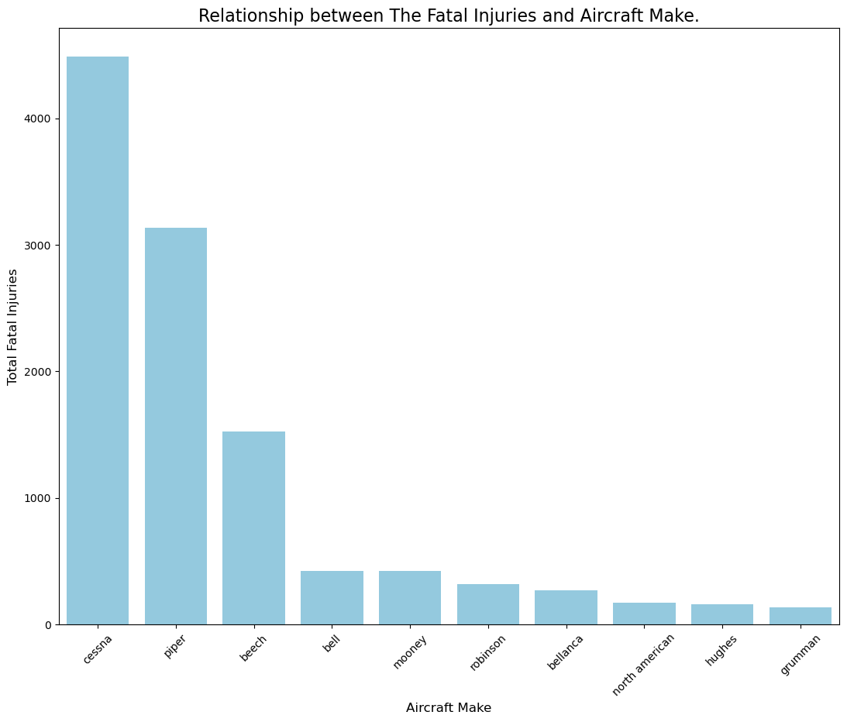
Relationship between The Fatal Injuries and The Aircraft Make
This visual shows that Cessna has the most fatal injuries as compared to the other types of aircraft makes. From my understanding this maybe because Cessna is the most used aircraft make as compared to the others

Slide 6
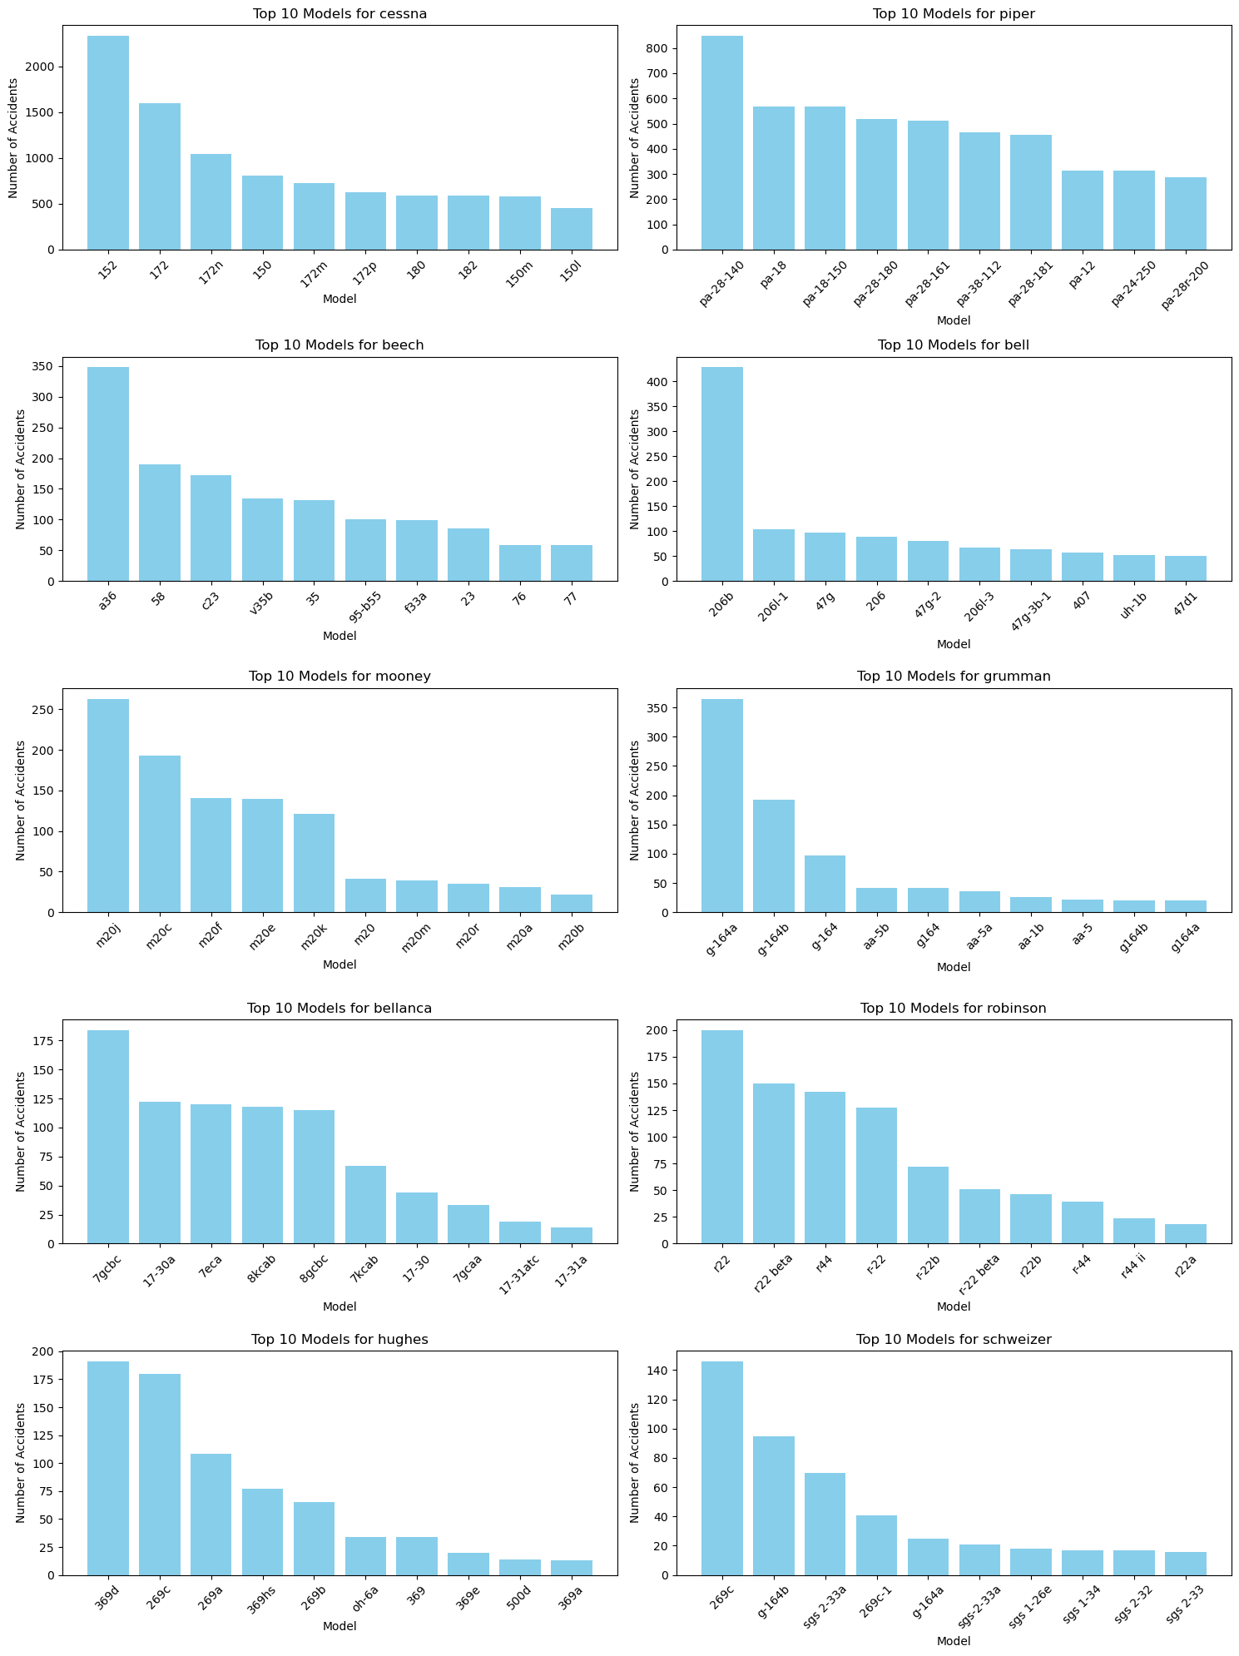
Top 10 Aircraft Models Used in the Top 10 Aircraft Makes

Slide 7
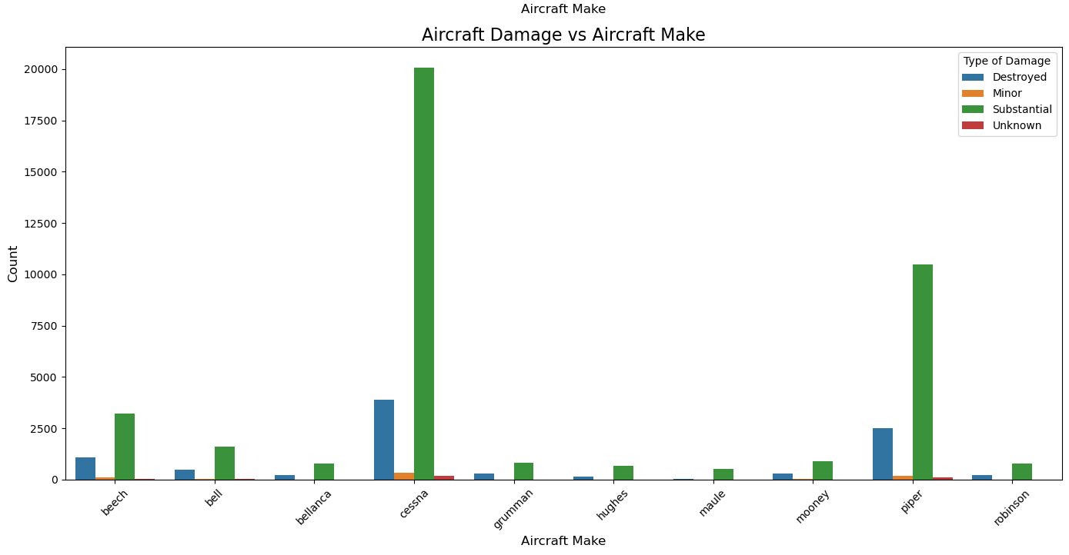
Relationship between Number of Accidents and Aircraft Make via Type of Aircraft Damage

Slide 8
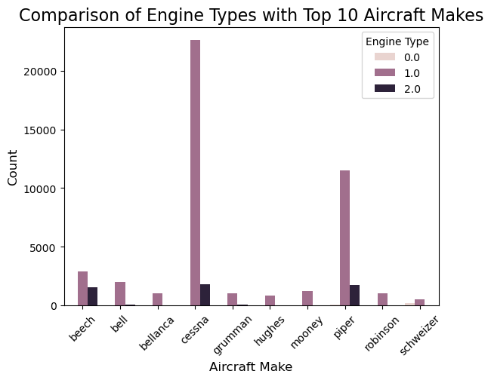
Comparison of Engine Types with Top 10 Aircraft Make
Engine type 1.0 is the most used type of engine used in the top 10 Aircraft makes

Slide 9
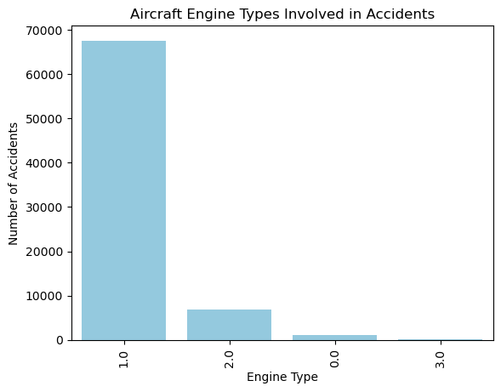
Aircraft Engine Types Involved in Accidents

Slide 10
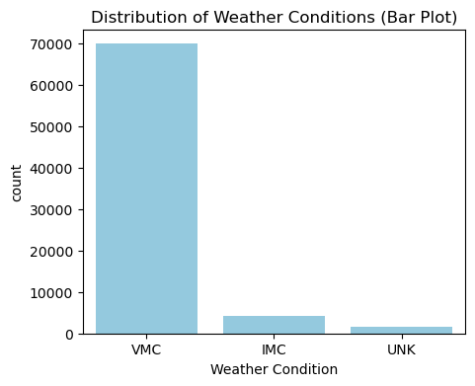
Distribution of Weather Conditions
Visual Meteorological Conditions (VMC)- Refers to weather conditions that the pilot can operate aircrafts using visual reference.
Instrument Meteorological Conditions (IMC) – Refers to weather conditions that the pilot has to operate an aircraft using instruments due to terrible weather conditions and low cloud cover that causes poor visibility.
UNK- Represents the unknown values

Slide 11
RECOMMENDATON
Most of the travels happen mostly in VMC majorly because it is a favorable weather for air travels but more accidents are being recorded maybe because pilots would assume that low risks may occur hence becoming negligent. Therefore the company should train their pilots to maneuver aircraft responsibly and being vigilant at all times.
Invest on aircraft such as Cessna-152 with engine since it is most used but should ensure that maintenance protocols are top notch, in order to reduce the number of accidents that happen.
Other than suggested model further research should be made in order to finally conclude using upcoming flight trends and modern technologies.
More research is required before measures and strategies are made to ensure operations when running the new industry go smoothly.

Slide 12
NEXT STEPS
Getting more information and further analysis is done so as to get more knowledge about the aviation industry before diving into it.
Data such as the number of passengers can the plane carry and the number o trips it can make so as to really know the efficiency and performance of an aircraft.

Slide 13
Thankyou!
Thankyou for listening to my presentation and if you have any questions please feel free to ask.
LISA MWANGI.
DATA SCIENTIST.
lisamwangi939@gmail.com

